Slide 1


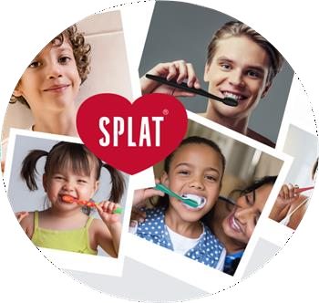
Splat Project
Global Trends Oral care trends E-com
Brand Positioning

Slide 2
Global Trends
2

Slide 3
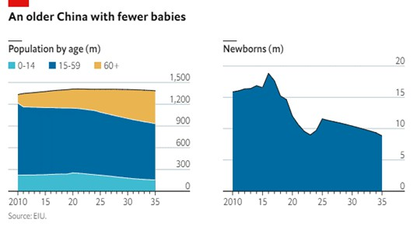
Socio-demographic situation
3
Population decline of 2 million from 2023 to 2024
As of 2023, about 20% of the population is aged 60 and older, projected to rise to 30% by 2035 → aging population → shrinking workforce
The median age - 39.6 years.
The proportion of children (aged 0-14) has decreased → lower birth rates.
Gender imbalance → 51% of males and 48.9% of females

Slide 4
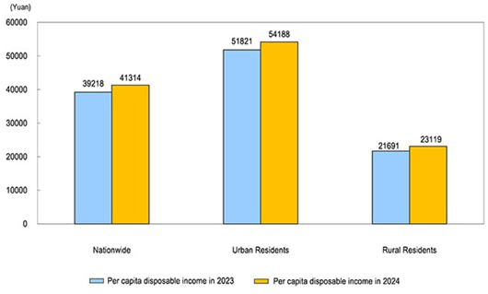
Households’ income (2024)
4
The nationwide per capita disposable income - 41,314 yuan:
nominal increase of 5.3% over
the previous year
real increase of 5.1% after deducting the price factor
The median of the nationwide per capita disposable income - 34,707 yuan → 5.1% increase
Growing upper-middle class - from 12% (in 2015) to 39% (in 2021)
Per Capita Disposable Income of Urban and Rural Residents Nationwide for 2024. Source: National Bureau of Statistics of China

Slide 5
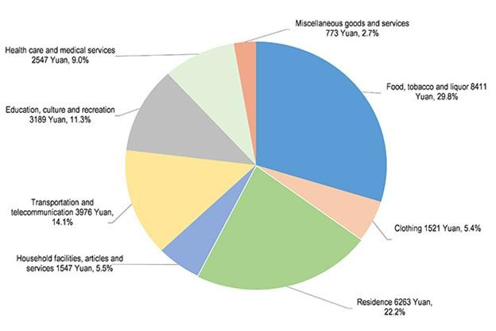
Per Capita Consumption Expenditure and Composition for 2024
5
The nationwide per capita consumption expenditure on health care and medical services was 2,547 yuan, an increase of 3.6%, accounting for 9.0 percent of the per capita consumption expenditure
Source: National Bureau of Statistics of China

Slide 6
6
RAPID GROWTH OF ONLINE PLATFORMS
CONSUMER TRENDS IN E- COMMERCE
SHIFT IN SPENDING CHANNELS
Douyin (TikTok's Chinese counterpart) GMV surged 80% from 2020 to 2021, reaching
RMB 830 billion
Growth in categories like
skincare and apparel
exceeded 200%
High engagement (2h per day– average)
Preference for interactive shopping experiences and detailed product information
Livestream shopping
usually offers discounts
Strong preference for quality over brand origin
Domestic products dominate due to their innovation and cost-effectiveness
Fashion trends are:
minimalism, sustainability,
conscious consumption, incorporation of traditional chinese elements (guochao)

Slide 7
7
Baby Boomers (1950-1964)
Generation X (1965-1979)
Spending Focus: Healthcare, personal care, leisure, and travel.
Values: Comfort, security, and personal
enrichment.
Oral care: Seek solutions for age-related oral health issues, such as sensitive gums and dentures.
Characteristics: Material wealth and cautious spending habits.
Spending Focus: High-end, durable products (luxury items,
automobiles, premium dining).
Values: Quality, cost-effectiveness, and status.
Oral care: Value efficacy over branding, focusing on plaque control and cavity prevention.
Millennials/Generation Y (1980-1994)
Generation Z (1995-2009)
Characteristics: Digital natives, heavily influenced by technology and social media.
Spending Focus: Premium products and
services that enhance lifestyle (fitness,
wellness, self-care).
Values: Enjoyment, health, and balanced
living.
Oral care: Prioritize convenience and personalization, favoring premium options like
targeted gum care.
Characteristics: Digitally connected, socially aware.
Spending Focus:
Experiences, aesthetics, emotional well-being.
Impulsive purchases influenced by social media and
peers.
Preference for luxury goods that align with their identity.
Oral care Increasingly health-focused, preferring
toothpastes with benefits like whitening, sensitivity relief, and herbal ingredients.

Slide 8
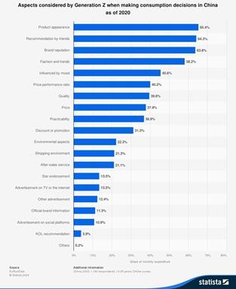
Strategies for Targeting Different Age Segments
8
Targeting Gen Z and Millennials
Omnichannel Marketing
Innovative Formulations
Eco-Friendly Packaging
Engaging Gen X
Loyalty Programs
Educational Content
Appealing to Baby Boomers
Traditional Media Presence
Health-Focused Messaging

Slide 9

LUXURY PRODUCTS CONSUMERS
9
Chinese luxury consumers are distinctly young, mostly under 40 years old. Comparatively, Western luxury consumers are dominated by senior citizens.
A growing segment -20–30 year-old generation (people who grew up with the one-child policy).
Younger consumers are distinctive and extremely individualistic. Consumers in this age range cherish social activities and have a unique notion of luxury products
Social media is
-> importance
an essential
of eWOM
marketing channel for them
(electronic word-of-mouth)
Reference: “Unlocking luxury purchase intentions in China: A study of consumer attitude, perceived value, and the moderating effect of perceived enjoyment” by Bilal M., Zhang Y., Cai S., Akram U. & Luu N. T. M.

Slide 10
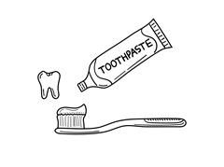
LUXURY IN TOOTHPASTE PRODUCTS
10
advanced technology
exclusive formulations
superior packaging
brand heritage
younger consumers - a broader self-care or lifestyle statement
older consumers - health benefits (Mintel, 2023)
Key Drivers of Luxury Toothpaste Adoption
Barriers to Adoption
Health and Wellness
Status and Exclusivity
Packaging and Aesthetics
Celebrity Endorsements and KOL Influences
Price Sensitivity
Efficacy Skepticism
Limited Brand Recognition

Slide 11
Oral care trends
11
Children; Those who wear braces
(orthodontic); The Elderly.

Slide 12
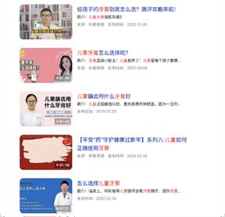
Children
12
Advertising of children's toothpaste is carried out through video clips with recommendations from doctors and parents, which increases the level of confidence in certain products;
“Only those who have used it can talk about it” - creation of online forums with parents and professionals sharing their real-life stories and opinions about choosing toothpastes for their children.
significant portion of the internet for the query ‘toothpaste for kids’

Slide 13
Children
13
When choosing a children's toothpaste, consumers consider the following aspects:
Age-appropriateness
Safeness of Ingredients (it is worth choosing a toothpaste containing fluoride, an effective ingredient in preventing tooth decay)
Ingredients to avoid:
Calcium carbonate
Sodium laureth sulphate (SLS), sodium laureth sulphate (SLES): as foaming agents, it can cause irritation to the oral mucosa
Propylene glycol: as a moisturiser, some children may be sensitive to it
Sodium saccharin, sucrose, fructose, galactose, etc.: as sweeteners they may affect gastrointestinal digestion or cause tooth decay
The effect that the paste provides (cleansing, fresh breath, strong gums, prevention of tooth decay)
Price

Slide 14
Children.
14
Taste preferences
The most popular flavour of children's toothpaste was strawberry
Watermelon
Grape
Pear ( the pear flavour is quite rare)

Slide 15
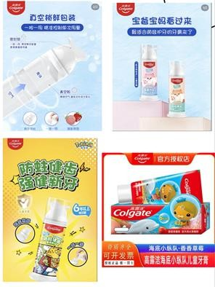
Children.
15
Competitors:Colgate (高露洁)
Flavours: peach, orange, strawberry
(Apple and blueberry are found only in one product line)
Emphasis on the content of natural fruit essence in the composition.
Advertising slogan: ‘Sweet and fruity flavour will make a child fall in love with tooth brushing’.
New paste design with cartoon characters.
The advert is in the form of a short cartoon with the characters.
New range of toothpastes with non-standard hermetic packaging, which allows to control the dosage of toothpaste per brushing.
+ Special collaboration with Pokemon on the packaging
Price : pack without dispenser - average 13元
Pack with dispenser - average 20 to 30元 on taobao

Slide 16

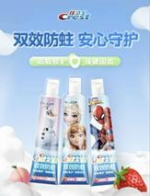
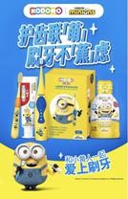
Children
16
Competitors: Crest (佳洁士)
Flavours: peach, strawberry (strawberry predominates) Packaging design - collaboration with Disney and Marvel (separate division into pastes for boys and girls).
Price: average 10元 on taobao
Competitors: Lion (狮王)
Flavours: apple, strawberry, melon, grape (Mostly strawberry flavour)
Collaborations with cartoons.
In the product adverts, the company emphasises on the safety of the toothpaste as it is safe to swallow.
Price: average 20元 on taobao

Slide 17
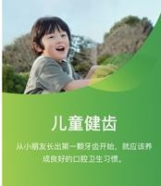
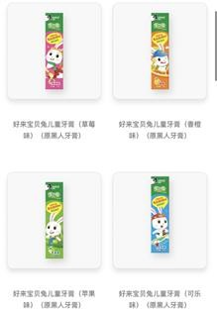
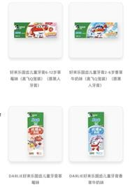
Children.
17
Competitors: Darlie (好来)
Company slogan: Children should develop oral hygiene habits from the time their first teeth appear. Healthy teeth and a bright smile for your children.
Unique black toothpaste for children.
Flavours: strawberry, apple, orange, cola, vanilla milk, berry flavour, peach
The packaging design is more minimalistic than other brands, but the design is recognisable. There is a collaboration with a cartoon, as well as unique characters of the brand.
Price: average 24元

Slide 18
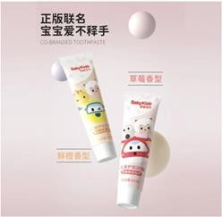
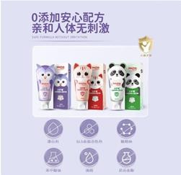
Children.
18
Competitors: Sakykids (舒客)
Flavours: strawberry, orange
Unique animal-shaped packaging (owl, cat and panda).
Calm colour palette of packaging. Price: average 12元
Observation - lack of variety of flavours, small number of paste ranges for children.

Slide 19
Elderly
Health Issues Faced by the Elderly
19
Among individuals that are 65 years old and above, the most frequent encountered dental pathologies include: periodontal disease, edentulism, dental caries, oral mucosal lesions, oral infections and temporomandibular pathology.
Herbal Toothpaste: help strengthen the gums and prevent oral diseases that may become more common with age (Yunnan baiyao)
Low-abrasive toothpastes: gently clean their teeth without damaging the enamel (Sensodyne)
Products to combat dry mouth: With age, the likelihood of developing xerostomia (dry mouth) increases
(Biotene Dry Mouth Oral Rinse)
Gum Strengthening (Listerine Gum Therapy)
Denture Care Products: Denture cleaning tablets and solutions are an important element of oral care for the elderly who use removable denture

Slide 20
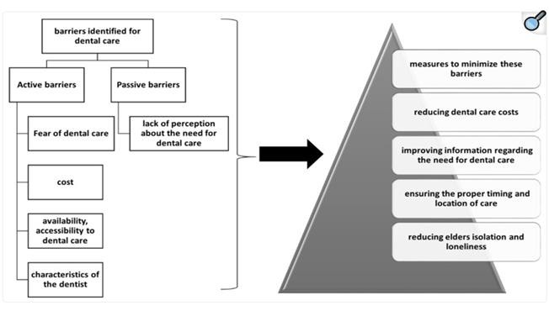
Barriers and methods to overcome them in dental care access of elderly
20
! The dental pathology can lead to chewing problems or a reduction in social interaction

Slide 21
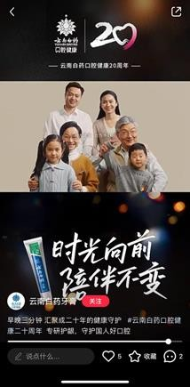
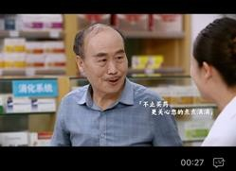
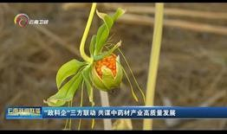
Elderly
21
不止买药，更关心您的点点滴滴 -
Not only to buy medicine, but also to care about your every detail
inform elderly consumers about the specific benefits of the products and oral care health
emphasizing importance of elderly oral care health
family

Slide 22
Orthodontic
Blogger suggest these products
22
Fluoride toothpaste: Protect gums and prevent tooth demineralization.
Orthodontic toothbrushes: The small head goes deep into the molar area, and the steel teeth can also brush the gaps. Electric toothbrush: The high-frequency vibration of the electric teeth can quickly clean the teeth, and the water generated by the vibration can also clean the gaps between the teeth, which is not compared with ordinary toothbrushes.
Water flosser : Can flush areas that the toothbrush cannot brush
Mouthwash : Mouthwash containing fluoride is recommended to prevent saprodontia. Dental floss: Removes food debris from between your teeth to keep your teeth healthy. Tooth mousse: To prevent tooth demineralization and saprodontia, swallowed no harm.
Effervescent tablet : Used for cleaning invisible braces with remarkable effect. It works better with a sonic cleaner, but is not
necessary.
Cleaning foam: Especially suitable for lazy people, suitable for use when going out. Directly squeeze the foam onto the invisible braces, wait a few minutes and rinse with water.
Retainer cleaner water: When traveling for work or eating, it is very convenient to use a retainer cleaner water. The single package is clean and hygienic, and the sterilization rate is as high as 99% in 60 seconds, without any delay. Whether it is a bite retractor, invisible braces or retainers can be put in, freeing your hands and giving you peace of mind.

Slide 23
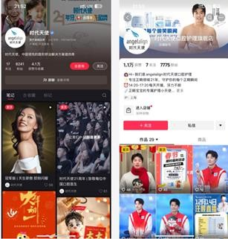

Orthodontic care products and the brands
23
Angelalign
Highlight professionalism with brand history and science popularization.
Content: advertising, brand and industry development documentary film, popularization of science, holiday greetings, honor and award, brand spokesman (national athlete), peripheral products(toys), brand activity.
抖音Douyin:
Let star athletes to endorse and establish a trustworthy image.

Slide 24
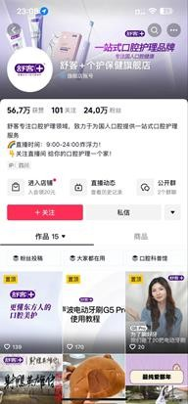
Orthodontic care products and the brands
24
舒克 Saky
The product line covers a full range of oral care products such as toothbrushes, toothpastes, mouthwashes, floss sticks, sonic toothbrushes and smart dental flushers
Target customers: young people
Xiao Zhan: A young actor popular with young people as
global brand spokespeople
Content: advertising video with the spokesman, product usage introduction, product test video, co- branding, advertising video with plot, live streaming

Slide 25
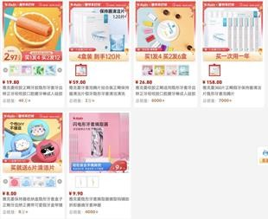
Orthodontic care products and the brands
25
雅克菱Y-Kelin
Orthodontic care products
With the industry certification of standardized plant, the successful establishment of professional testing center and technology research and development center, products are exported to Germany, France, the Netherlands and other more than 30 countries
Content: Through the melodrama to narrow the distance with the audience, so that the audience can into the use situation Content: advertising/product introduction video/article with plot

Slide 26
E-Commerce
26
Trends in promoting oral care
products online and main features

Slide 27



E-Commerce: Trends in promoting oral care products online and main features
27
Xiaohongshu
Douyin WeChat
Recommend oral product care through bloggers.
Recommend oral product care by partnering with a live stream.
Create your own business account.
Short-form video content Interactive mini-programs Influencer (KOL) marketing Gamified promotions
Types of content: mini dramas, expert advice, call to action, live streams, product overview, concise themed cartoons (about 15
mini games, videos of a
sec), giant posts
toothpaste in the city,
showing themed.

Slide 28

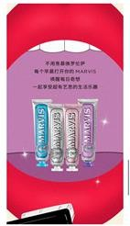
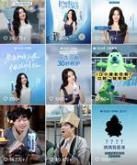
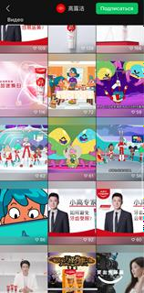
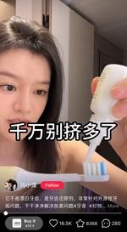
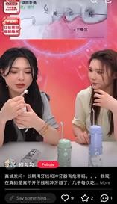
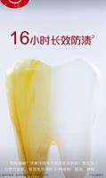
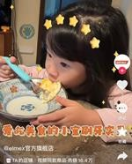
28
Examples of competitor’s content
Douyin
WeChat
Xiaohongshu

Slide 29
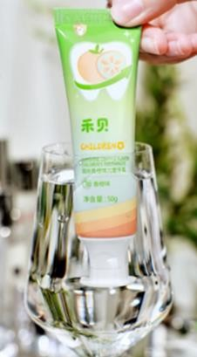
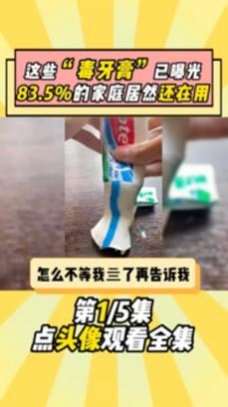

Kuaishou
29
Short Video Content
Live Streaming and Influencer Marketing (KOL)
Sponsored Ads
Emphasis on educational marketing
Minimal and Media-Driven Design.
Augmented reality tools that show how a product works or how it fits into a daily routine.
Social Proof Connections. Customer reviews, user generated videos and testimonials.
Payment experience.
Cross-marketing and
personalization.

Slide 30
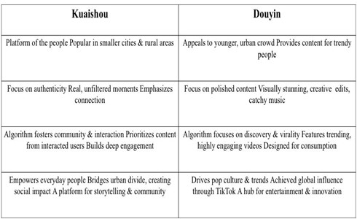
30
Difference between Kuaishou and Douyin. The main individual characteristics of
Kuaishou.
Kuaishou and Douyin dominate China’s short-video
scene. Kuaishou thrives on authentic, trust-based livestream sales, featuring farm goods and handmade items. Its strength lies in the ability to connect people through genuine, relatable content. It’s not just a platform for entertainment—it’s a space where ordinary people share their lives, build communities, and even make a living.
Douyin, meanwhile, focuses on trendy, high-end products and brand collaborations, creating a virtual shopping mall experience.
Both platforms cater to distinct audiences with unique styles.

Slide 31
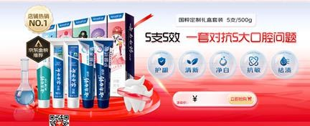
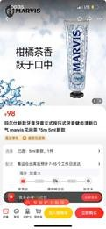
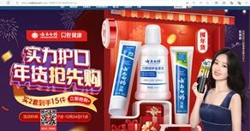
JD.com
31
Description:
Many brands have a personal page that is completely customized. It provides information on sales hits, the effectiveness of the brand's products (toothpastes, toothbrushes, mouthwashes), information on promotions and adverts. The product card provides brief basic information about the product and its specifics. There is a slightly more detailed description with instructions on how to use the product and product certification.
Design:
Original personalized design.
Many product cards feature not only the product, but also a visual presentation of what effect it has.

Slide 32
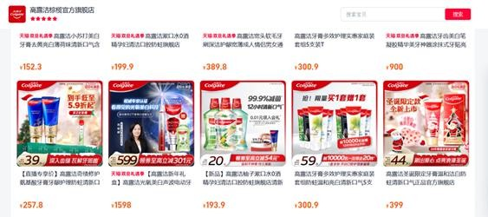
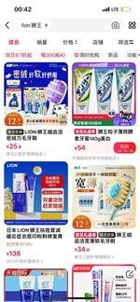
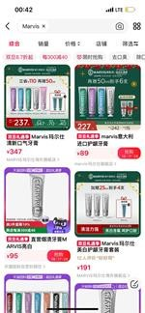
Tmall
32
Description:
Brief description: title + specialization.
Design:
Main product images: If the sale is
handled by the company itself, e.g. Marvis, the design is in the company's corporate style, the same everywhere. If another channel is selling, there will be the same design elements, but different from the brand design.

Slide 33
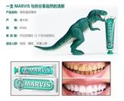
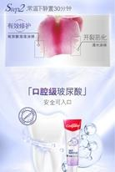
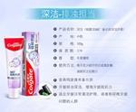
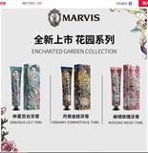
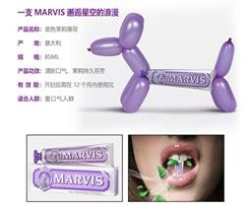
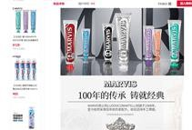
Koala.com
33
Description:
The short name includes: country of manufacturer, Functionality of the paste, flavour, effect.
The description below is very detailed. It lists all the
information about the company, rules of use, rules for getting delivery. The description of unique features of different products of the product is presented.
Design:
The main product image is most often a product on a white background, without unnecessary elements.
In addition to the main picture in the product card,
there is a huge brochure with an original design. It clearly shows the features of the toothpaste.

Slide 34
Content duplication. How do brands adapt for each platform?
34
Douyin: Uses trend-driven short videos and influencer collaborations.
Xiaohongshu: Emphasizes long-form product reviews and influencer-driven storytelling.
WeChat: Focuses on interactive mini-programs, expert Q&A, and community engagement.
Kuaishou: Relies on gamification and short-form videos
duplication lowers engagement:
duplication increases engagement
Platforms with distinct content preferences (e.g., Douyin, Xiaohongshu, WeChat) perform worse when brands simply reuse content.
Users expect platform-specific content,customized
campaigns receive much more engagement.
Short videos, live streams, and gamified promotions generate higher engagement than static ads.
Example: Colgate’s campaign featuring a reality TV
star on Douyin attracted more engagement than its
identical static ad on other platforms.
Oral care brands exhibit a mix of content duplication and platform-specific adaptation. While some content is repurposed, companies often tailor their approach based on each platform’s audience preferences.

Slide 35
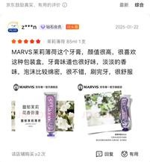
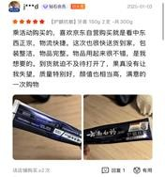
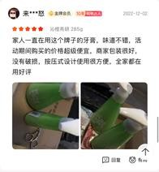
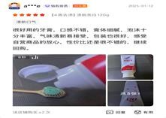
Comments on marketplaces about the design and product packaging
35
Marvis: received the biggest amount of comments. The customers noted stylish packaging, novel design, many claimed that this toothpaste is perfect for gifts
Yunnan Baiyao: packaging was found simple yet very elegant and stylish, giving high-end feeling
Perioe: Push-type packaging
praised for convenience
LION: package is simple yet exquisite

Slide 36
Foreign brands packaging strategies
36
Corporate Identity: Major competitors integrate their brand’s corporate style into packaging to convey company culture,product features and difference from the market competitors.
Natural Ingredients & Trust: Many brands highlight natural ingredients and the end result of using the toothpaste on the package to appeal to consumer trust.
Limited Edition Designs: Some brands incorporate Chinese cultural elements (e.g., unique fonts, patterns, herbal themes) for limited edition releases.
When designing a package, it is important to maintain a unique and memorable design tied to brand values, to release limited editions for major holidays, blending brand identity with Chinese traditions, aim for balanced, classic packaging—subtle yet culturally respectful.

Slide 37
Brand positioning
37
Actual trends; Key factors of purchase decisions;
Current representation of the company; Recommendations

Slide 38
Eco-Friendly Brand
38
Consumers are prioritizing sustainability in their purchasing decisions (eco-friendly product market is particularly evident in urban centers)
65% of Chinese consumers express willingness to pay a premium for eco-friendly products (Millennials and Gen Z are leading this shift)
The Gen Z group aged 16 to 24 years has the strongest awareness of preventive oral
care + purchase electronic toothbrushes and other products for their parents
Over 90% of young Chinese buyers are interested in sustainable products, as they view them as environmentally responsible
Biodegradable packaging and low-carbon manufacturing processes
75% of survey - third-party certifications and transparent sustainability reports influence their purchase decisions

Slide 39
Eco-Friendly Brand. Other trends
39
Gen Z and Millennials:
Trends and fashion in all directions
Does not know English at a high level
Consumers have a high loyalty to toothpaste brands
Marketing strategies, such as gifts, limited-time discounts, etc.
Fluoride-free and safe toothpaste for children
Tastes: Mint, fruit and tea are the most popular flavors
Effects: Whitening, anti-caries and fresh breath, anti-sensitivity, anti-inflammatory and hemostatic effects
Personalized demand: consumers hope to be able to choose toothpaste that suits their oral problems and taste preferences, and also hope that toothpaste can have personalized packaging and design.
Prioritizing: Consumers are willing to pay higher prices for high-end toothpaste with better efficacy and ingredients

Slide 40
Key Factors of Purchase Decisions for Toothpaste and Oral Care Products
40
Featuring innovative ingredients and technologies that offer enhanced benefits
Established Brands: brands with a history of quality and safety are preferred
Preference for Natural Products
Cost-Effectiveness
Oral care products with the title marked "fresh breath" have the highest sales volume
"fluoride-containing" and "anti-caries" are mentioned more in children's oral care products
The sales volume of products marked "portable" and "independent packaging" are among the top ten
现在牙膏价格确实越来越离谱了，牙膏购买频率高，希望商家少一些花里胡哨，回归产品本质。

Slide 41
Packaging
41
Eco-Friendly Packaging; Natural Ingredient Emphasis;
Usage of advanced technologies;
Lack of Localization:
SPLAT’s product packaging and marketing materials primarily use English and Russian, with limited Chinese adaptation
Design may focus too much on international style and ignore the cultural characteristics and consumer preferences of the Chinese market.

Slide 42
Packaging
42
Insufficient market segmentation
Packaging design may lack segmentation strategies for different consumer groups in the Chinese market. For example, there may not be obvious differentiation in packaging design for the gift market and the general consumer market No specific festival packaging;
Design Complexity:
Competitor brands in China often use gold accents, soft pastels, or traditional motifs to create a sense of premium quality and trust Incorporate localized color psychology !
No mascot for children product line

Slide 43
Current representation of the company
43
Issue:
Low engagement and localized promotions (lacks high engagement or storytelling that resonates with local users);
Low level of tailored content;
No specific festive promotions tied to major Chinese shopping holidays;
Low understanding of products usage;
No mascot for children product line;
No special storytelling about children product line and health care advices;
The official page in Xiaohongshu does not have a single style;
Lack of aesthetic photos;

Slide 44
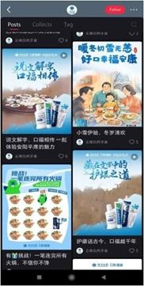
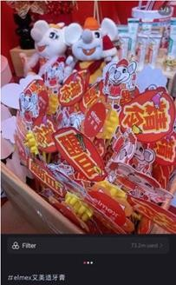



44
Current representation of the company
Competitors examples

Slide 45

Recommendations:
45
Post more photos and videos of products outdoors in nature on social media accounts to show consumers how much the brand values environmental protection:
cooperate with influencers from all over Russia;
Focus on a few products at first, introduce the functions and features of the products in detail, and introduce more different styles of products after consumers have a certain understanding of the brand;
Chinese adaptation/translation of the labels on the product packaging;

Slide 46
Recommendations:
Chinese adaptation/translation of the labels on the product packaging;
46
Incorporate Chinese cultural elements into packaging design, combine traditional Chinese patterns, colors and cultural symbols, and enhance the cultural affinity of products:
Auspicious cloud pattern
Traditional flower patterns: such as peonies, lotus, etc.
Calligraphy font
Traditional craftsmanship and materials

Slide 47



Recommendations:
47
Increase the interactivity of packaging design: Design interactive packaging, such as spliced and remodelable packaging boxes, encourage consumers to share their modified works to social media and increase brand exposure
Create special design for ”gift” lines

Slide 48


Recommendations:
48
Add user-generated content (UGC)
Launch social media challenges, such as the "Green Life Challenge", inviting consumers to share lifestyles related to Splat
products and increase user participation
Pay attention to brand joint branding and cross-border cooperation
① Cooperate with other brands that focus on ecology to launch limited edition products to attract consumers of both brands.
② Cooperate with environmental protection organizations to carry
out public welfare activities and enhance the brand's social image to share lifestyles related to Splat products and increase user participation.

Slide 49
Recommendations:
49
Edit storytelling and engagement with the audience
Healthcare advices, aesthetic photos, content for children, content about ingredients of the toothpaste and etc
Create mascot for children product line:
A mascot should be cute and unique. It can be depicted with other animals or fruits to display the taste of the toothpaste
packages with characters-friends of the mascot; a collectible sticker in the package with mascot. In this case, the child will want to collect a collection of stickers, which will encourage parents to buy a children's line

Slide 50


